Slide 1
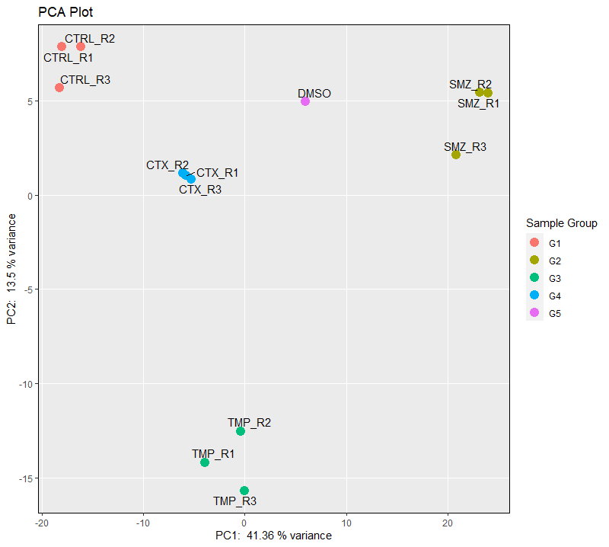
QC plots
Can we remove the groups name form plot and define them aside as you did with G1, G2, etc?
Can we take out the DMSO from plot? Since does not have repetition.
3D PCA plot can be an option if you want (optional).
Plot massage:
1- Genome expression changes between control and treatments
2- Variation among the experimental groups

Slide 2
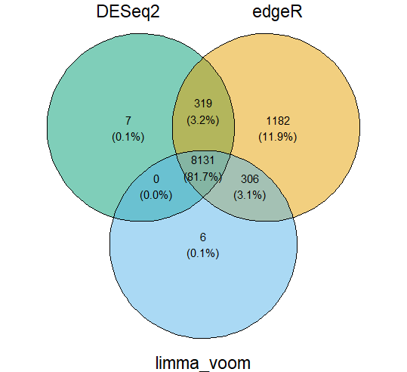
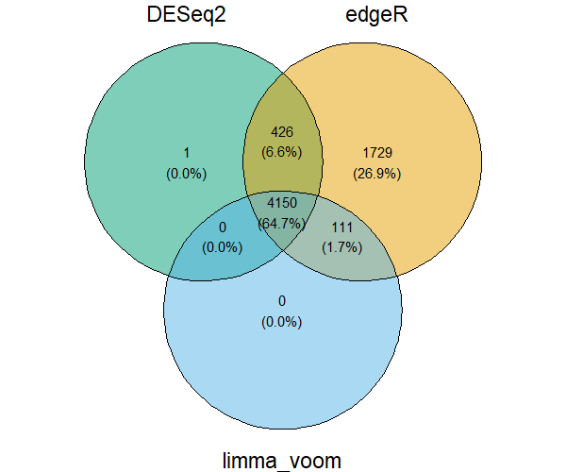

Venndiagrams
SMZ vs CTRL
TMP vs CTRL
CTX vs CTRL
Plot massage:
1- Three different statistical methods (DESeq2, edgeR, Limma) has been used for detecting the DEGS

Slide 3
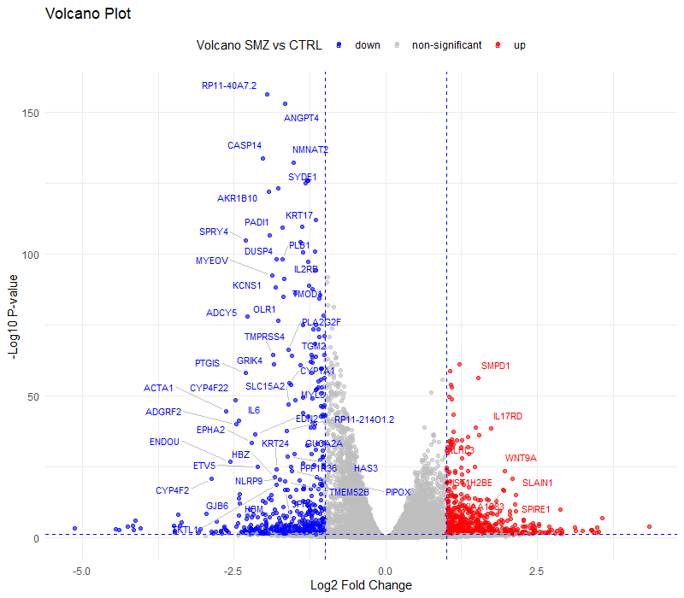
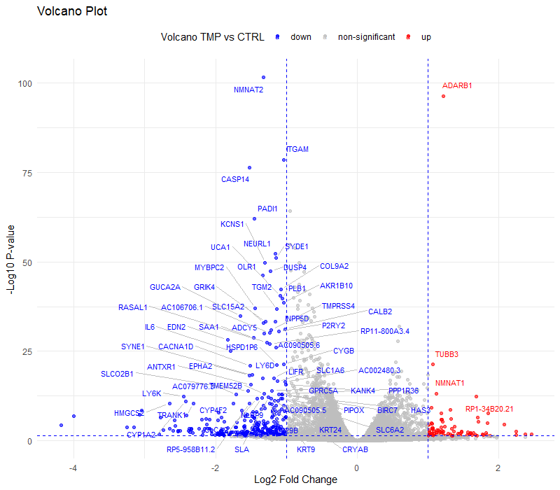
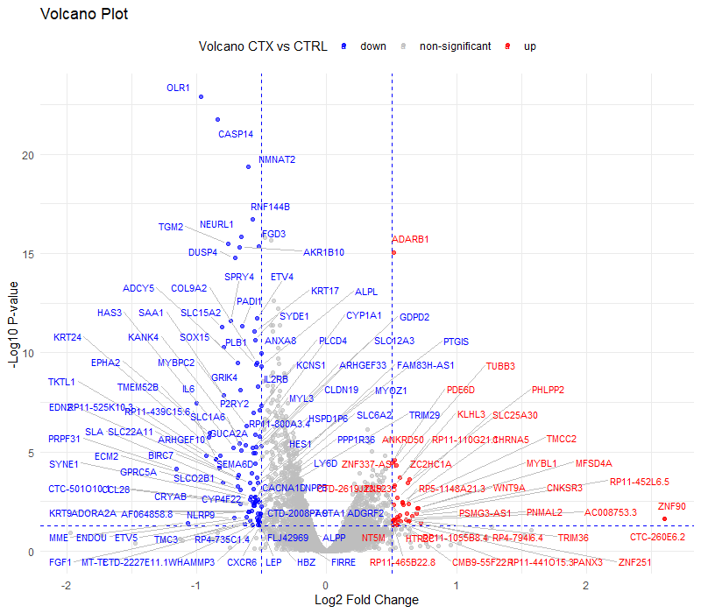
VolcanoPlots
Can we take the genes name out from the plots and instead mentioned how many DEGs detected in each condition?
Up----> upregulated genes
Down----> downregulated genes
Plot massage:
Significantly DEGs in each condition

Slide 4
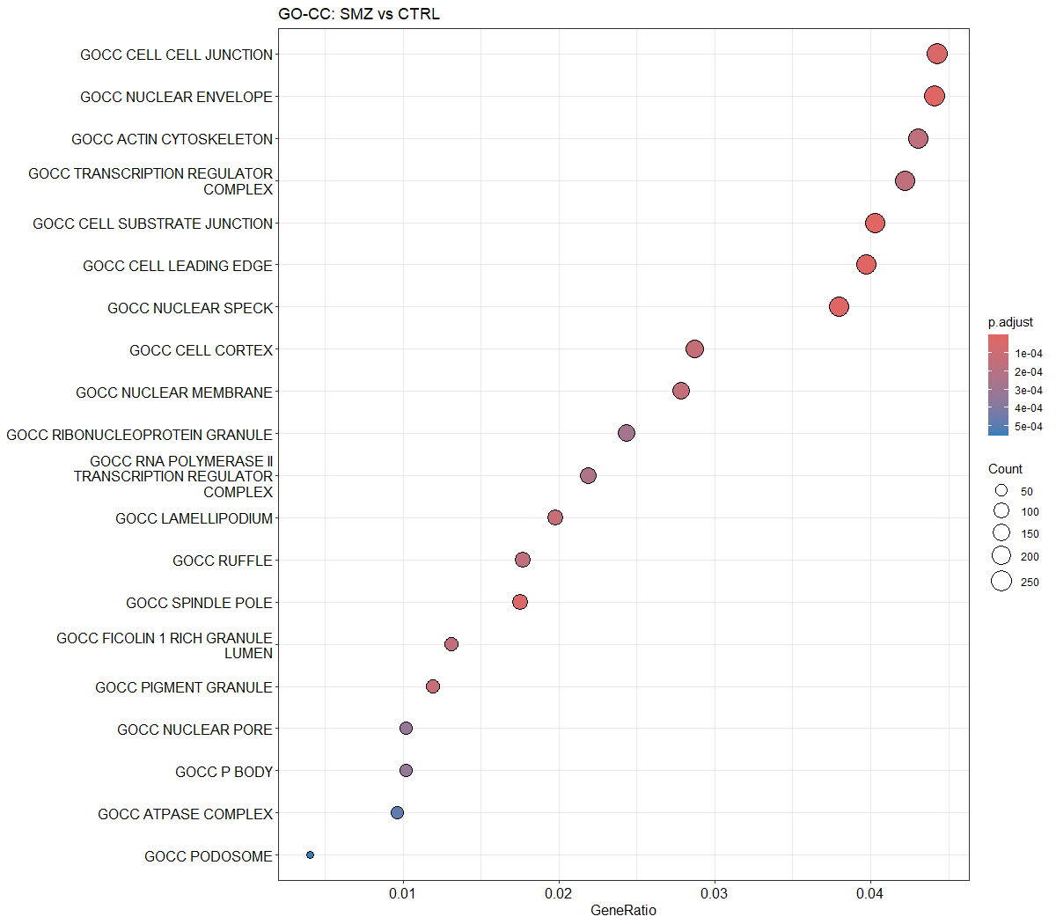
Enrichment analysis: GO_CC
Can we get GSEA analysis for the enriched cell_cell junction?
(SMZ vs CTRL Gene Ontology
Cellular component)----> as plot description on top or bottom
Its worth to have the pathway pvalue in GSEA plot.
Do you think we can mention the enrichment score as well? Needed?

Slide 5
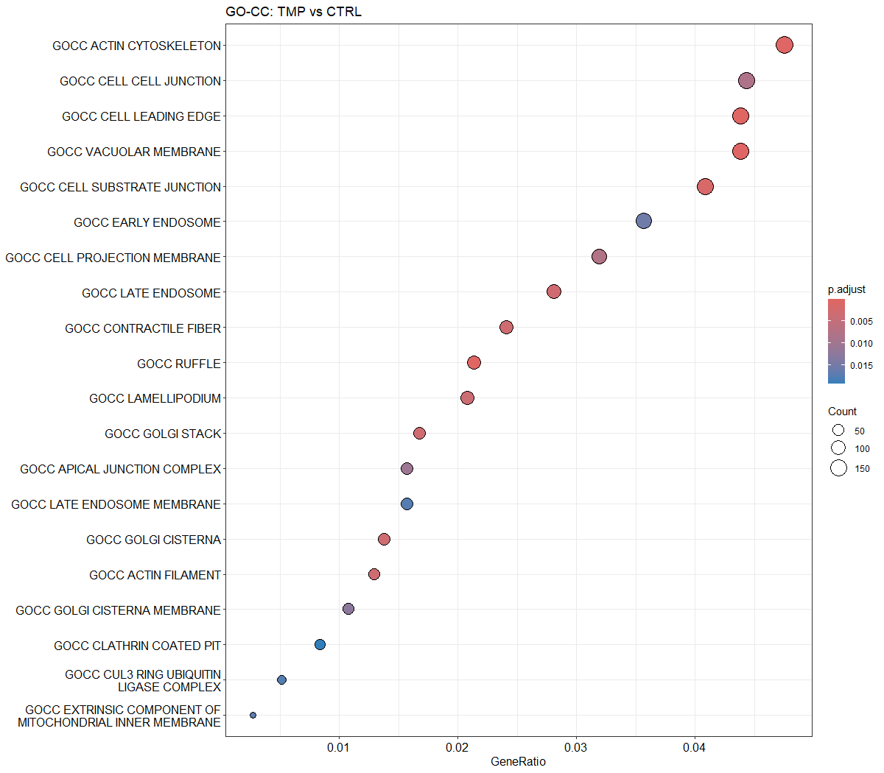
Enrichment analysis: GO_CC
Can we get GSEA analysis for the enriched cell_cell junction?
(TMP vs CTRL Gene Ontology
Cellular component)----> as plot description on top or bottom
Its worth to have the pathway pvalue in GSEA plot.
Do you think we can mention the enrichment score as well? Needed?

Slide 6
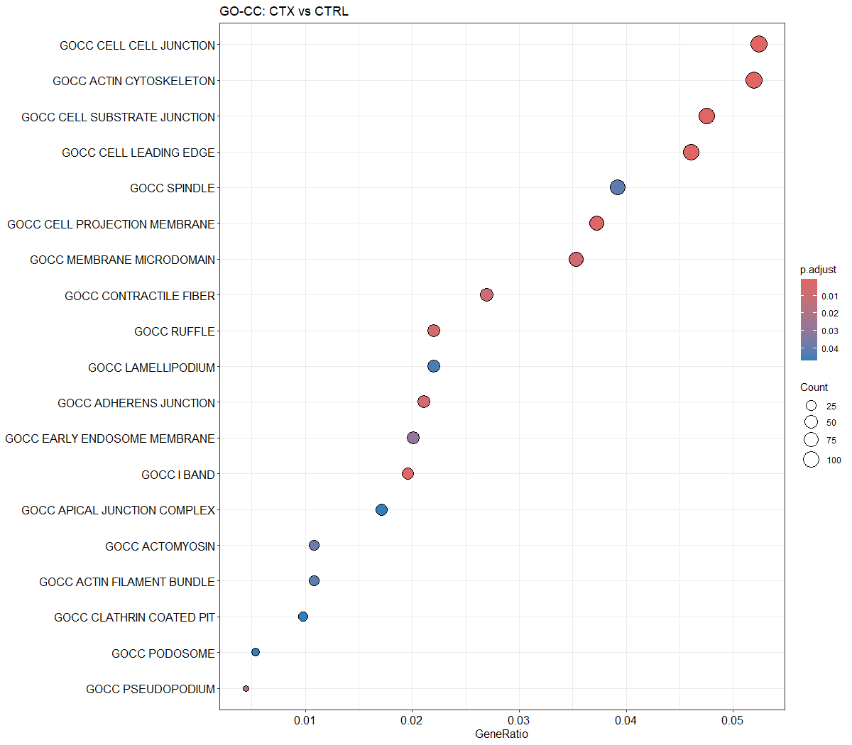
Enrichment analysis: GO_CC
Can we get GSEA analysis for the enriched cell_cell junction?
(CTX vs CTRL Gene Ontology
Cellular component)----> as plot description on top or bottom
Its worth to have the pathway pvalue in GSEA plot.
Do you think we can mention the enrichment score as well? Needed?

Slide 7
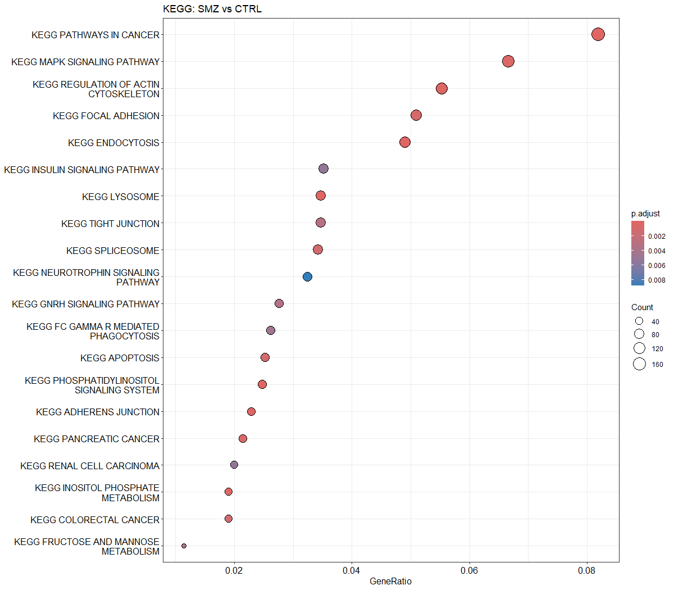
Enrichment analysis: KEGG database
Can we get GSEA analysis for the enriched MAPK pathway?
(SMZ vs CTRL KEGG)----> as plot description on top or bottom
Its worth to have the pathway pvalue in GSEA plot.
Do you think we can mention the enrichment score as well? Needed?

Slide 8
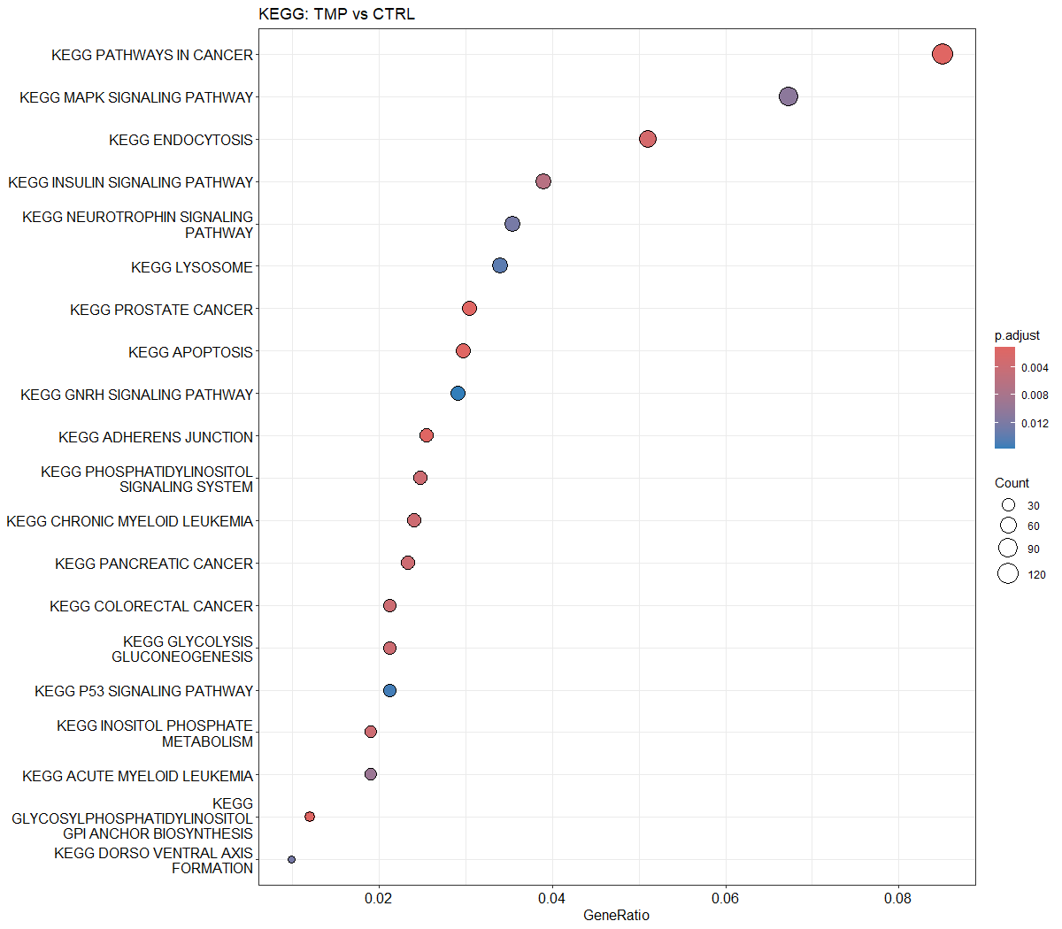
Enrichment analysis: KEGG database
Can we get GSEA analysis for the enriched MAPK pathway?
(TMP vs CTRL KEGG)----> as plot description on top or bottom
Its worth to have the pathway pvalue in GSEA plot.
Do you think we can mention the enrichment score as well? Needed?

Slide 9
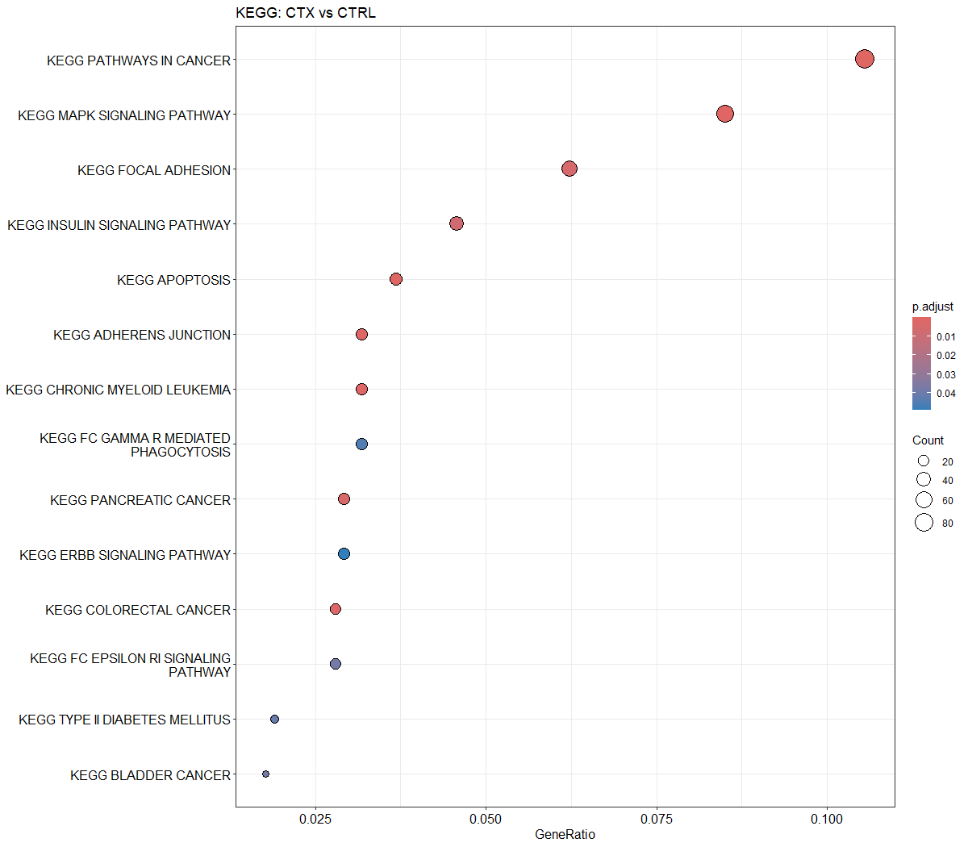
Enrichment analysis: KEGG database
Can we get GSEA analysis for the enriched MAPK pathway?
(CTX vs CTRL KEGG)----> as plot description on top or bottom
Its worth to have the pathway pvalue in GSEA plot.
Do you think we can mention the enrichment score as well? Needed?

Slide 10
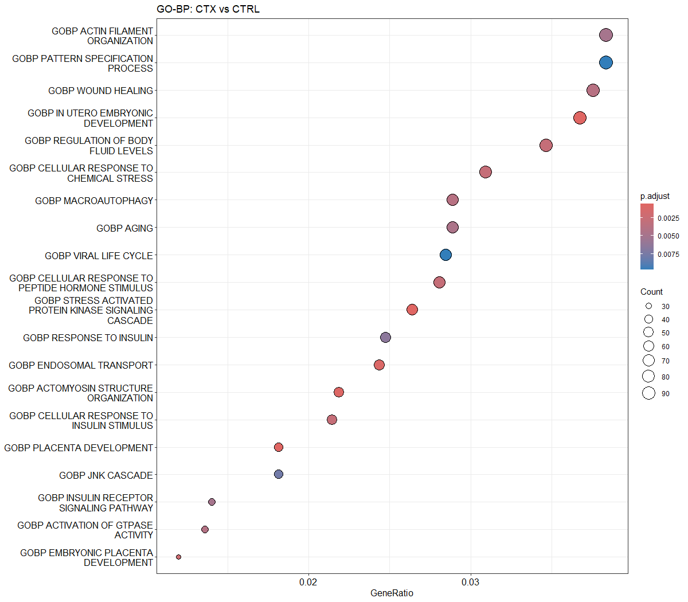
Enrichment analysis: GO_BP
Can we get GSEA analysis for the enriched JNK pathway?
(CTX vs CTRL Gene Ontology
Biological process)----> as plot description on top or bottom

Slide 11
Heatmaps for Tight Junction genes
We were interesting to having one heatmap per subsets of cell_cell junction genes (including CTRL-SMZ-TMP-CTX) but seems impossible since the number of genes among treatments are not equal. So, lets have separated ones.
Heatmap1: SMZ vs CTRL (85 genes)
Heatmap2: TMP vs CTRL (57 genes)
Heatmap3: CTX vs CTRL (36 genes)
The list of genes are in excel file (Cell-Cell junction. Tight junction).
Heatmaps for Adherence Junction genes
We were interesting to having one heatmap per subsets of cell_cell junction genes (including CTRL-SMZ-TMP-CTX) but seems impossible since the number of genes among treatments are not equal. So, lets have separated ones.
Heatmap1: SMZ vs CTRL (97 genes)
Heatmap2: TMP vs CTRL (60 genes)
Heatmap3: CTX vs CTRL (48 genes)
The list of genes are in excel file (Cell-Cell junction. Adherence junction).

Slide 12
Heatmaps for Gap junction Junction genes
We were interesting to having one heatmap per subsets of cell_cell junction genes (including CTRL-SMZ-TMP-CTX) but seems impossible since the number of genes among treatments are not equal. So, lets have separated ones.
Heatmap1: SMZ vs CTRL (6 genes)
Heatmap2: TMP vs CTRL (7 genes)
Heatmap3: CTX vs CTRL (5 genes)
The list of genes are in excel file (Cell-Cell junction. Gap junction).
Heatmaps for Desmosome genes
We were interesting to having one heatmap per subsets of cell_cell junction genes (including CTRL-SMZ-TMP-CTX) but seems impossible since the number of genes among treatments are not equal. So, lets have separated ones.
Heatmap1: SMZ vs CTRL (12 genes)
Heatmap2: TMP vs CTRL (0 genes)
Heatmap3: CTX vs CTRL (3 genes)
The list of genes are in excel file (Cell-Cell junction. Desmosome).

